Slide 1
Why Have Negative Nominal Interest Rates Had Such a Small Effect on Bank Performance? Cross Country Evidence
Jose A. Lopez, Andrew K. Rose, and Mark M. Spiegel*
Sveriges Riksbank
October 23, 2018
*Comments are my own and do not necessarily reflect the views of the Federal Reserve Board of Governors or the FRBSF

Slide 2
Low interest rates concern for banks
Following financial crisis, rates reduced towards “zero lower bound” (ZLB)
Potential obstacle to bank profitability
  Nominal deposit rates could not be reduced below zero without eroding banks’ customer base.
  Low interest rates reduce bank profitability [Jobst and Lin (2016)].

Slide 3
Concerns confirmed empirically
Borio, et al (2017):
  Bank profitability reduced at low rates of interest
Claessens, et al (2018):
  Similar results driven by reduction in interest rate margins
CGFS (2018):
  10k banks, 45 jurisdictions
  Net interest margins fall with ↓ in 3-mo rates
Borio and Gambacorta (2017):
  Bank lending less responsive to policy rates around ZLB
  Suggests a weakening of the monetary transmission mechanism

Slide 4
More results for low positive rates
Delis and Kouretas (2011):
  Increased risk tolerance by banks at low rates
Bikker and Vervliet (2017):
  US bank panel
  Confirm bank profitability reduced primarily due to reduced interest margins
  Find that adjustments on other margins can maintain profitability

Slide 5
Even worse at negative rates
Deposit rates likely hit a hard stop at the zero bound
  Banks generally unwilling to charge negative nominal interest rates on deposits, especially for smaller customers
Eggertson, et al (2017): Negative rates disrupt monetary transmission
  Evidence from aggregate data from five countries and the euro area as well as bank-level data from Sweden.
Alternative view:
  Negative rates may increase lending by increasing cost of hoarding cash [e.g. Rostagno, et al (2016)]

Slide 6
Economies under negative nominal interest rates
Bech and Malkhozov (2016):
  4 CBs in Europe since 2014
  Transmission between policy and money market rates similar under negative rates similar to low positive rates
Turk (2016):
  Danish and Swedish bank margins roughly stable across ZLB
Arce, et al. (2018):
  Banks with reduced net interest margins under negative rates often poorly capitalized and take less risk

Slide 7
Micro studies of negative rates
Bank-level studies primarily indicate banks mitigated adverse effect of negative rates on bank profitability and lending
  Increases in non-interest income (such as increased fees)
  Adjustments in funding allocations to rely less on deposits
Ability to adjust depends on both bank business model and size, which influence reliance on deposit vs wholesale funding

Slide 8
Banks adjust through fees and lending
Heider, et al (2017): 46 eurozone banks 2013-2015
  Negative rates in euro area induced deposit-dependent banks to cut lending, and reallocate loans towards more risky firms.
Nucera, et al (2017): 111 eurozone banks
  Negative rates induced smaller banks to increase riskiness
Basten and Mariathasan (2018): 68 Swiss banks
  Banks with higher excess reserves raised fees and interest income to compensate for negative liability margins
Demiralp, et al (2017): 205 euro area banks
  HD banks extend more loans under negative rates than LD

Slide 9
Multi-currency panel conditions for global shocks
Economies move to negative rates at different times
  Fixed time effects control for global conditions
  Global shocks particularly relevant over sample period [Rey (2015)]
Some countries in sample never experience negative rates
  Can be viewed as a difference-in-difference study
  Compare banks in economies that experienced negative rates, before and after policy rates turned negative
Local conditions also likely affect both bank profitability and monetary policy
  Respond by instrumenting proxies for local conditions

Slide 10
First study pooling European and Japanese banks under negative rates
Annual income statements for 5,113 banks from 2010-2016
  14 different currencies, one of which is the 19 country euro
Countries “go negative” at different times for different reasons
  Example: Movements into negative rates different in floating and pegged exchange rate countries
  Latter respond more to pressures that might undermine the peg.
Sample also includes large number of banks
  Allows analysis of banks most exposed to negative interest rates
  Split data into sub-samples by: a) bank size, and b) reliance on deposits.

Slide 11
Results: Bank profitability unaffected by negative nominal interest rates
No substantive effect on net income from negative rates.
  Sample includes high share of small and high-deposit banks
  Both considered more exposed to negative rate losses
Do find statistically significant losses in net interest income
  Losses significant on both lending and “other” interest income
  Mitigated by reductions in interest expenses, but not sufficiently
Notably, banks do not substantially reduce deposit expenses
  Heterogeneity: Large banks do achieve reduction in deposit expenses, small banks don’t

Slide 12
Losses on net interest income made up on non-interest income
Significant gains in net non-interest income
  Increases in fees
  Increases in other non-interest income (capital gains, gains on securities, insurance)
Differences by bank type
  Large banks also reduce other interest expenses more than their smaller counterparts.
  Low-deposit (LD) banks do better under negative interest rates than high-deposit (HD) counterparts
    LD banks actually suffer bigger reductions in net interest income, but also achieve larger increases in net non-interest income

Slide 13
Data
Fitch Global Banking database
  Balance sheet and income statement variables for individual banks, 2010-2016
  Sourced “… directly through web crawlers, alerts, by direct request and data feed”
28 European countries and Japan
  Variety of monetary regimes, including monetary unions, exchange rate peggers, and inflation targeters
  Data begins 2 years before negative nominal interest rates
  Includes all negative nominal interest rate countries through 2016

Slide 14
Variety of countries with different monetary regimes
Negative rates at different points in time, if at all.
Five economies experienced negative nominal policy rates: Denmark, EMU, Japan, Sweden, and Switzerland
  Denmark first into negative rates July 2012
  Swiss interest rates most negative (on sight deposit rates at -0.75%)
Similar countries that did not go negative
  Bulgaria, Czech Republic, Hungary, and the UK
Allows time fixed effects to account for global conditions
  Diff-in-diff: Not all experience negative rates, none for entire sample

Slide 15
Data set is large
Over 5,100 banks and more than 30,00 observations
Allows examination of effects of negative rates on banks that differ by size and deposit-reliance
  Identify large banks as those with assets exceed $10 billion (1/8 of sample)
  Define high-deposit (HD) as deposits exceeded 75% of funding (4/5 of sample)

Slide 16
Complications
Multiple accounting methods
  Keep observation with most popularly-used method by country
  Also drop banks that use unconventional accounting systems for their country
Generally choose unconsolidated observations
  Report consolidated if unconsolidated unavailable
Annual observations, usually 4th quarter
  Japanese banks report in first quarter
Truncate outliers at 1% and 99%

Slide 17
Losses on net interest income made up on non-interest income
Significant gains in net non-interest income
  Increases in fees
  Increases in other non-interest income (capital gains, gains on securities, insurance)
Differences by bank type
  Large banks also reduce other interest expenses more than their smaller counterparts.
  Low-deposit (LD) banks do better under negative interest rates than high-deposit (HD) counterparts
    LD banks actually suffer bigger reductions in net interest income, but also achieve larger increases in net non-interest income

Slide 18
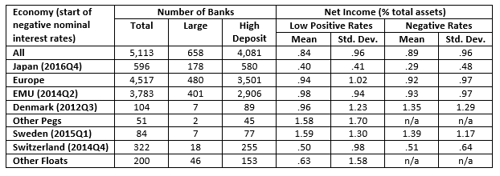
Little overall difference in profitability across ZLB
Descriptive Statistics

Slide 19
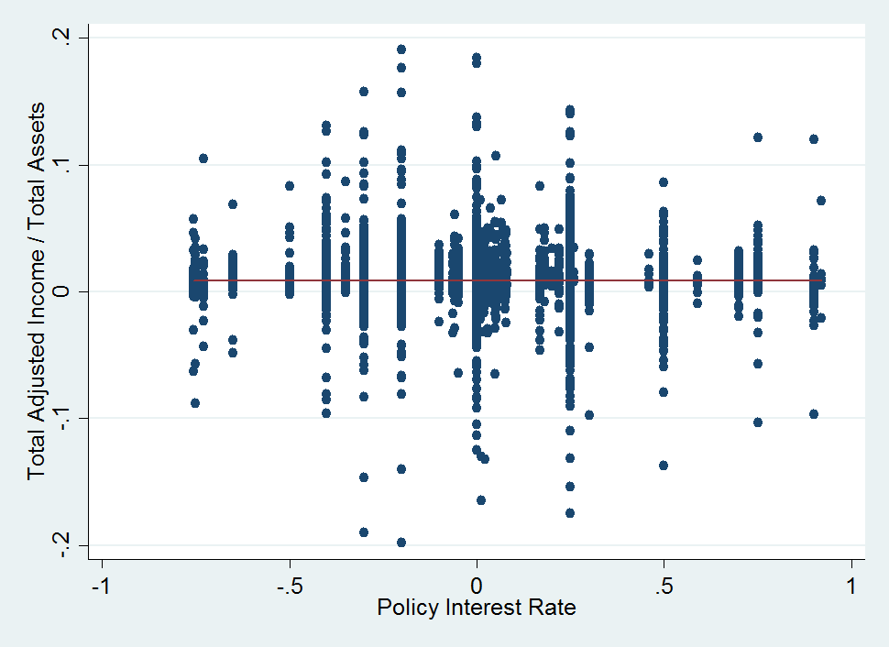
No apparent profitability differences in raw data
Figure 1: Bank profitability under positive and negative policy rates

Slide 20
Base specification
Conventional least-squares panel specification:
Y_{ijt} = βNEGI_{jt} + {δ_{i}} + {θ_{t}} + ε_{ijt} (1)
where:
Y_{ijt} is dependent variable for bank i in economy j for year t
NEGI_{jt} is 1 if country j had a negative nominal policy interest rate during year t, and 0 otherwise (nominal rates>1 are dropped)
{δ} and {θ} are comprehensive sets of bank- and time-specific fixed effects
ε represents a residual, assumed to be well-behaved

Slide 21
Base specification (2)
Coefficient of interest is β
  Average effect of negative nominal interest rates
  Use robust standard errors, clustered by bank.
Consider number of measures of bank performance
  Calculated as ratios of total assets
  Drop outliers, observations outside (1,99) percentiles
Confirm results insensitive to the use of earning assets instead of total
Exclude values of net income (to total assets) greater than 20% in absolute value

Slide 22
Benchmark results
Negative Nominal Interest Rates and Bank Profitability
 | Denominator | Sample of Banks [Maximum Observations]
Regressand | Total Assets | All [30,792] | Large [4,001] | Small [26,791] | High-Deposit [24,957] | Low-Deposit [5,756]
Net Income | Total Assets | .031 (.021) | .059 (.037) | .025 (.026) | .013 (.022) | .124* (.056)
Net Interest Income | Total Assets | -.054** (.016) | .010 (.031) | -.055** (.018) | -.029 (.015) | -.244** (.053)
Net Non-Interest Income | Total Assets | .052** (.011) | .030 (.022) | .047** (.013) | .008 (.011) | .323** (.045)
Smoothed Return on Assets | Average Assets | .033** (.012) | .074** (.020) | .026 (.015) | .006 (.012) | .089 (.055)
Smoothed Return on Equity | Equity | -.104 (.168) | .523 (.349) | -.220 (.198) | -.705** (.175) | 2.395** (.776)
Net Income | Earning Assets | .020 (.027) | .051 (.041) | .016 (.032) | .006 (.028) | .064 (.074)
Net Interest Income | Earning Assets | -.085** (.018) | -.036 (.034) | -.081** (.022) | -.062** (.018) | -.259** (.075)
Net Non- Interest Income | Earning Assets | .073** (.013) | .060* (.025) | .064** (.015) | .029* (.013) | .339** (.054)

Slide 23
Base results indicate small negative rate impact
Economically small – but positive – and statistically insignificant effect on bank net income, compared with low positive rates
Masks large movements in income components
  Net interest income falls significantly by around 5.4 bp
  Almost precisely offset by gains in net non-interest income of 5.2 bp.
Offsetting results suggest banks are reluctant to charge their depositors negative rates
  Results in losses on interest income
  Compensate for losses with gains from non-interest income

Slide 24
Differences across bank types
Income differences
  Increases in net income under negative rates marginally significant only for LD banks
  Reduction in interest income and offsetting rise in non-interest income stems primarily from small and LD banks
  Large and HD banks insignificantly affected
Smoothed ROAs and ROEs
  Smoothed ROA paints an even more positive picture
  Heterogeneity in ROE results
    Positive change for LD banks (210 bp), negative for HD banks (-71 bp)

Slide 25
Base results robust to variety of perturbations
Sensitivity Analysis
 | Net Income | Net Interest Income | Net Non-Interest Income
Whole Sample (Default) | .031 | -.054** | .052**
Drop Systematically Important Banks | .043 | -.042** | .083**
Drop Top-100 Banks | .044* | -.041** | .082**
Drop 2010 | .019 | -.064** | .053**
Drop 2016 | .052* | -.043** | .052**
Drop Germany, Japan | .106 | -.167** | .197**
Substitute country- for bank- fixed effects | .034 | -.050** | .052**
Drop time-fixed effects | -.045** | -.179** | .120**
Add country-time Fixed effects | .102 | -.293** | .258**
IV, using output growth and gap, CPI inflation, unemployment rate | .025 | -.044* | .024
Control for output growth and gap, CPI inflation, unemployment rate | .052 | -.056** | .083**
Control for 4 macro variables, Herfindahl index, yield curve slope | .041 | -.058** | .081**

Slide 26
Results are robust
Effects on total income small, positive and typically insignificant, except for estimator without time effects
Effect of negative nominal rates on net interest income negative and significant throughout
Effect on net non-interest income stays positive and is significant, except for the IV estimator

Slide 27
Decomposition of net interest income
Split net interest income into gross interest income and expenses
Further decompose gross interest income into interest income on loans and “other” interest income
Splitting gross interest expense into spending on customer deposits and other interest expenses.

Slide 28
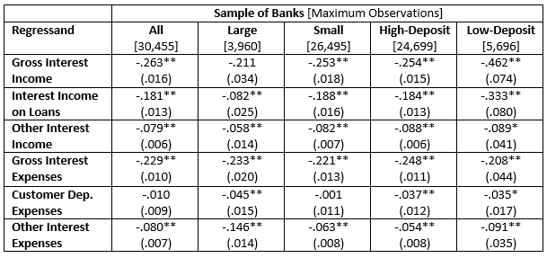
Results for decomposed of net interest income
Negative Nominal Interest Rates and Bank Interest Income and Expenses

Slide 29
Interest expense cuts less than revenue losses
Both gross interest income and expense show economically significant and statistically significant declines
  Decline in expenses is smaller
Decline in gross interest income largest for loan income
  Other interest income decline also significant
  Customer deposits insignificant
Matches conventional wisdom
  Banks suffer interest losses but can’t pass fully on to depositors
  Hence, bank net interest income declines

Slide 30
Differences across banks
Large banks seem more nimble than smaller banks
  Suffer smaller and insignificant declines in gross interest income
  Also cut expenses further, avoiding losses on net income
LD banks suffer significantly greater losses in gross interest income, especially income from loans
To offset losses, LD and HD banks lower interest expenses
  However, LD banks lower “other interest expenses” more
  More reliant on other, market-based funding sources
  Differences in deposit expenses much smaller

Slide 31
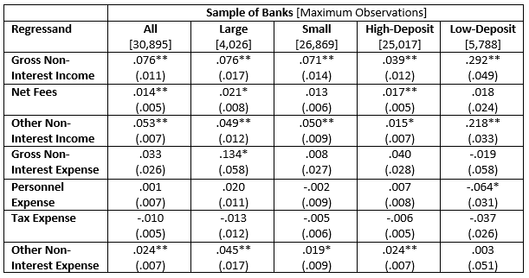
Decomposition of non-interest income
Negative Nominal Interest Rates and Bank Non-Interest Income and Expenses

Slide 32
Interest expense cuts less than revenue losses
Increase in net non-interest income stems from an increase in gross income, rather than a decline in expenses
Two sources increasing gross income, both significant:
  Increase in net fees
  Improvements in other types of non-interest income, such as capital gains and gains on securities and insurance
But change in most non-interest expenses insignificant
  Exception is “other non-interest expenses,” including capital gains on securities and interest expenses, which increase

Slide 33
Differences across banks
Few substantive differences between large and small banks
Relatively large discrepancies across HD and LD banks
  Modest differences in point estimates for non-interest expenses
  Increase in gross non-interest income for LD banks about 10 times size of that enjoyed by HD banks
    Most from increases in non-fee income, which may reflect gains on securities
    May be associated with unanticipated movements into negative rates
Benign impact of negative rates might in part reflect immediate capital gains on bond holdings for LD banks
  However, remaining under negative rates may not be painless
  Medium-tern impacts of negative rates may differ

Slide 34
Further non-interest income decomposition
More Components of Non-Interest Income
 | Sample of Banks [Maximum Observations]
Regressand (% observations available) | All [13,982] | Large [2,910] | Small [11,072] | High-Dep [10,299] | Low-Dep [3,673]
Net Gain/Loss on Trading Securities, Derivatives (29%) | .023 (.012) | .034* (.013) | .005 (.024) | .011 (.014) | .079* (.032)
Net Gain/Loss on Assets at Fair Value (6%) | .039 (.027) | .045 (.046) | .035 (.033) | .027 (.034) | .084 (.064)
Net Gain/Loss on Other Revalued Securities (46%) | .144** (.009) | .044** (.014) | .166** (.011) | .080** (.010) | .195** (.030)
Net Insurance Income (1%) | .024 (.028) | -.001 (.017) | .154 (.136) | .077 (.065) | -.012 (.021)

Slide 35
Large role for capital gains
Potential for selection bias
  More than half of sample missing for other variables
Still, interested in direct measures of capital gains and losses where available
Find that large and LD banks experience positive returns on trading securities/derivatives
  Small and HD banks insignificant, but positive
Also positive returns in “other” category, but category itself opaque and likely to differ across banks

Slide 36
Differences across monetary regimes
Data includes three different types of monetary regimes
  Large number members of EMU, (3 Baltic countries joined)
    Largest negative rate monetary regime
  Floating exchange rates
    Japan, Sweden and Switzerland (but not Czech Republic, Hungary or the UK) experienced negative nominal interest rates.
  Fixed exchange rates
    Bulgaria and Denmark (Estonia, Latvia and Lithuania prior to EMU entry)
    Only Denmark experienced negative interest rates.
Analysis implicitly exploits this panel variation
Next, reexamine results by monetary regime

Slide 37
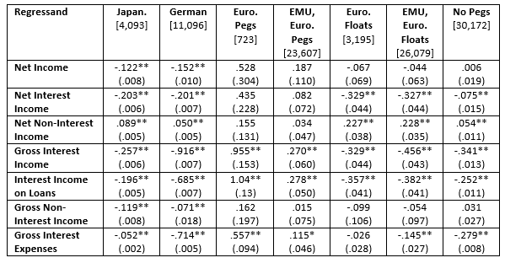
Results for different monetary regimes
Negative Nominal Interest Rates Effects Across Economies

Slide 38
Results indicate importance of panel approch
Results for Japan and Germany erroneously negative
  Unable to control for time fixed effects; interpret with caution
  Demonstrates advantage of cross-country panel
  Literature often uses banks from single monetary regime
Other samples more credible
  Countries with exchange rates pegged to the Euro
  European countries that maintained flexible exchange rates
  Flexers plus Eurozone
  All economies with flexible exchange rates

Slide 39
Much heterogeneity across monetary regime panels
None of the five panel estimates indicate significant effect of negative nominal interest rates on bank profitability
  Stark contrast with national results indicating significant decline in bank profits in both Japan and Germany
Decomposition of sub-panels consistent with full sample
  Observed significant effect on net interest income always negative
  Significant coefficients for net non-interest income positive
Result that negative rates only have a small overall effect appears driven by floating exchange rate economies

Slide 40
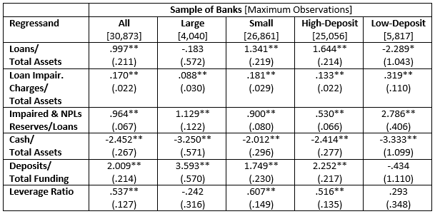
Results for activity
Negative Nominal Interest Rates and Other Bank Activity

Slide 41
Heterogeneity in lending response
Increase in lending overall
Driven by small banks and HD banks (1.6 pp)
  In contrast, small and HD bank lending decline (2.3 pp)
Other results
  Banks hold less safe assets (cash, reserves)
  Loan impairment charges increase
    Suggest deterioration in conditions
  Deposit funding increases
    LD an exception
    Likely borrow from other sources

Slide 42
Conclusion (1)
Examine banks under negative nominal interest rates
  First study under negative rates for different monetary regimes
  Panel allows conditioning for global shocks, and dis-aggregating by both size and dependence on deposit-funding
Find little overall impact on bank profitability, compared with low positive rates
Components of income respond significantly
  Decline in net interest income
  Largely offset by increases in non-interest income
Results driven by countries with floating exchange rates, and small or LD banks

Slide 43
Conclusion (2)
Overall, results suggest banks fare relatively well under negative nominal rates, compared to low positive
Considerable heterogeneity raises caution in concluding that monetary transmission mechanism unchanged
Particularly since positive returns in “other non-interest income” may be unsustainable over medium term
  Capital gains from negative interest rate surprises unlikely to persist
  Plan to test in future research

